Slide 1
Insurance Policy Analysis

Slide 2
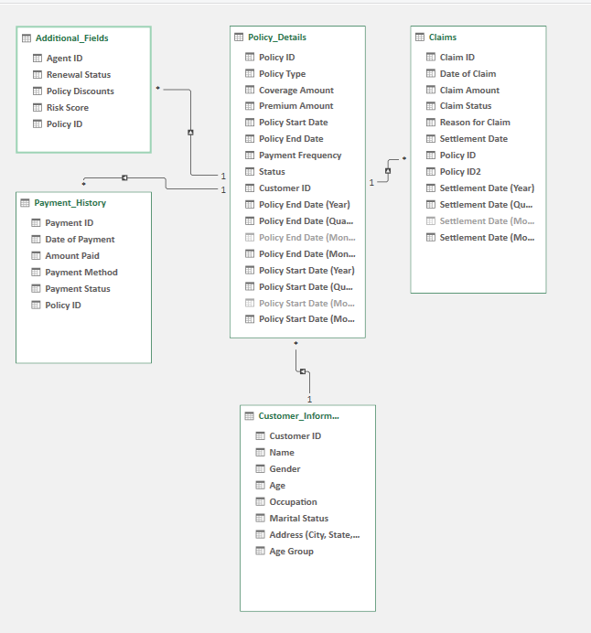
Excel file : Policy details

Slide 3
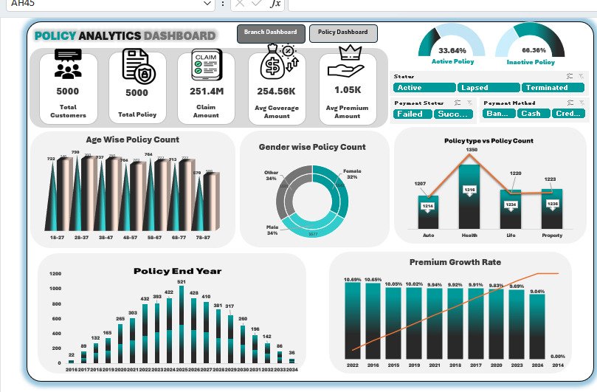
Sample

